Slide 1


Domain Name System (DNS)
Understanding DNS: How it works, components, types, and security measures.
Course : Data Communication & Computer Networks
Presented by : Anurag Tiwari, Wagish Vatsa & Aman
Presented to : Dr. Amritanjali

Slide 2

Introduction to DNS
1
Translation
2
Simplification
DNS translates domain names into IP addresses.
Eliminates the need to remember numerical IP addresses.
3
Facilitation
4
Example: www.google.com →
Works as the phonebook of the internet.
142.250.180.206

Slide 3
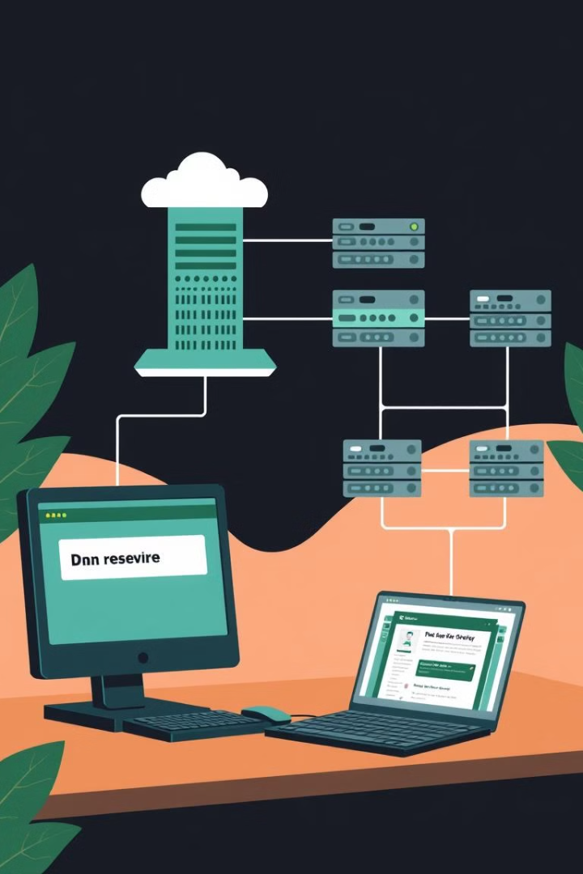







How DNS Works
Enter Domain
User enters a domain name in a web browser.
DNS Resolver
Request sent to the DNS Resolver.
Root Server
Resolver queries the Root Server.
TLD Server
Root Server directs resolver to the TLD Server.
Authoritative Server
TLD Server points to the Authoritative Name Server.
IP Address
Authoritative Name Server provides the IP address.
IP Resolving
The resolver returns the IP address to the browser.

Slide 4




DNS Hierarchy
1
Root DNS Servers: Direct queries to the correct TLD server.
2
Top-Level Domain (TLD) Servers: Handles .com, .org, .edu, etc.
3
Authoritative Name Servers: Stores actual domain name-to-IP mappings.
4
Recursive Resolvers: Fetches DNS records when not in cache.

Slide 5
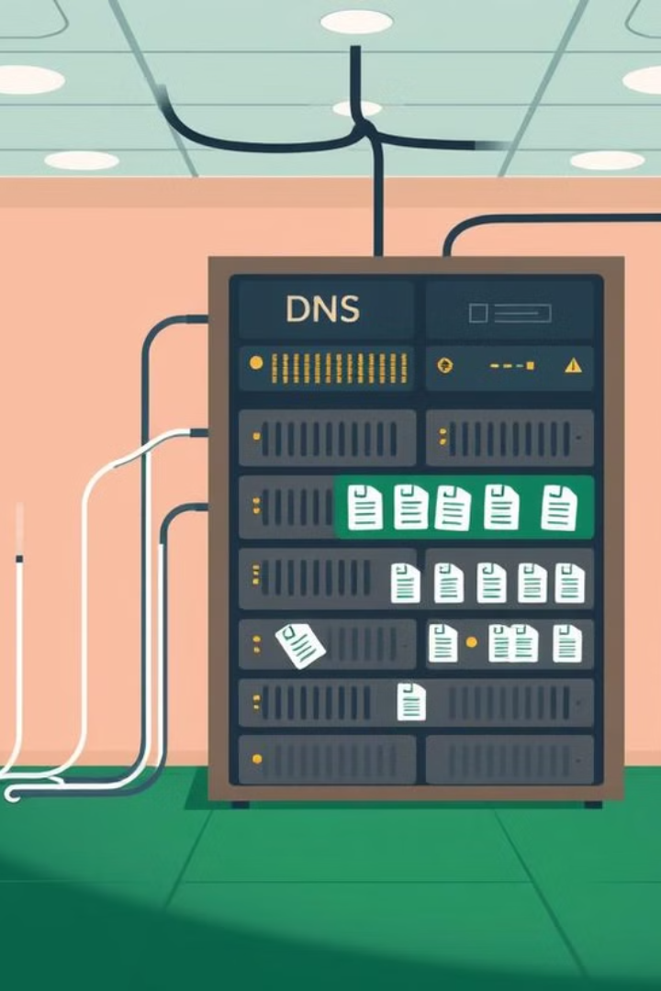
Components of DNS
DNS Resolver
Root DNS Servers
TLD Servers
First point of contact for user queries.
Manage domains like .com, .net, .org.
Directing to TLD servers.
Authoritative DNS Server
DNS Records: Stores domain-related information.
Stores domain-to-IP mappings.

Slide 6

DNS Records (Resource Records)
A Record
MX Record
Maps domain names to IPv4 addresses.
Specifies mail exchange servers.
AAAA Record
TXT Record
Maps domain names to IPv6 addresses.
Stores arbitrary text data.
NS Record
CNAME Record
Specifies the authoritative DNS server.
Provides an alias for a domain.

Slide 7
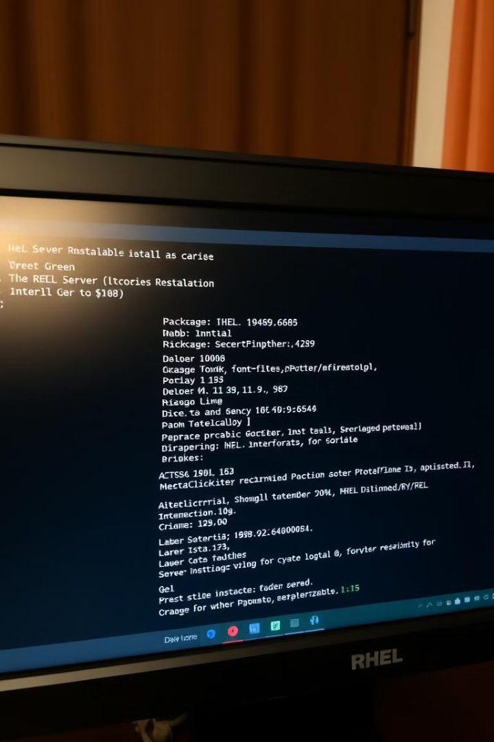
Installing DNS Server on RHEL
Install Named Package
sudo yum install named -y
Named is the main package for setting up a DNS server.

Slide 8
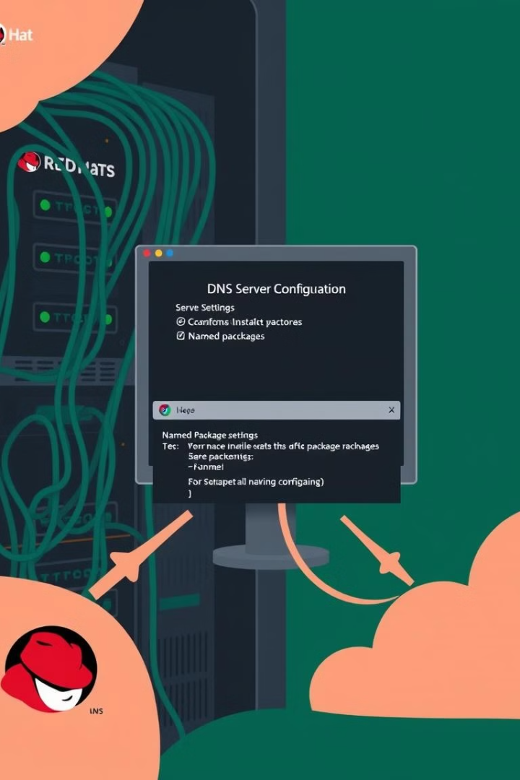
Configuring the Named Service
Edit Configuration File
sudo nano /etc/named.conf
Modify options to allow queries from your network.
Set Up Forward Zone File
sudo nano /var/named/yourdomain.com.zone
Example zone file for yourdomain.com.

Slide 9
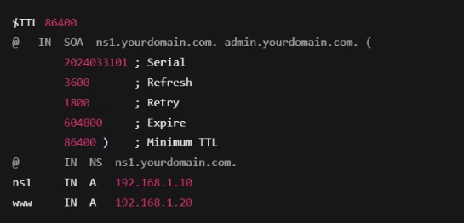
$TTL 86400
@ IN SOA ns1.yourdomain.com. admin.yourdomain.com. (
Example zone file for yourdomain.com:
2024033101 ; Serial
3600 ; Refresh
1800 ; Retry
604800 ; Expire
86400 ; Minimum TTL
);
@ IN NS ns1.yourdomain.com.
ns1 IN A 192.168.1.10
www IN A 192.168.1.20

Slide 10

Setting Up the Reverse Zone File
Create Reverse Zone File
sudo nano /var/named/1.168.192.in-addr.arpa.zone
Example reverse zone file.

Slide 11
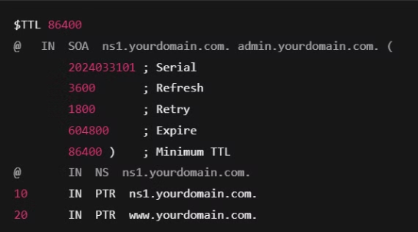
$TTL 86400
@ IN SOA ns1.yourdomain.com. admin.yourdomain.com. (
Example zone file for yourdomain.com:
2024033101 ; Serial
3600 ; Refresh
1800 ; Retry
604800 ; Expire
86400 ; Minimum TTL
);
@ IN NS ns1.yourdomain.com.
10 IN PTR ns1.yourdomain.com.
20 IN PTR www.yourdomain.com.

Slide 12

Starting the DNS Server
Start Named Service
sudo systemctl start named
Enable Named Service
sudo systemctl enable named

Slide 13
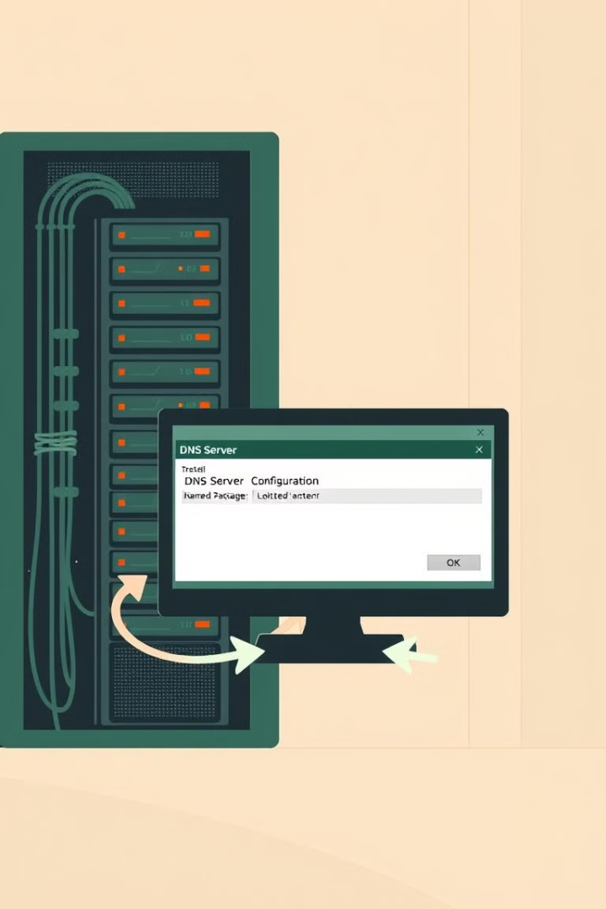
Test DNS Configuration
Checks syntax of named.conf
named-checkconf
Checks zone file
named-checkzone yourdomain.com /var/named/yourdomain.com.zone
Tests DNS resolution
dig @localhost yourdomain.com

Slide 14

DNS Security Threats
1
DNS Spoofing
2
DDoS Attacks
Attackers inject false records into the cache.
Overloads DNS servers with excessive requests.
3
Man-in-the-Middle
4
DNS Hijacking
Interception and modification of DNS queries.
Attackers modify DNS settings to redirect users to malicious websites.

Slide 15
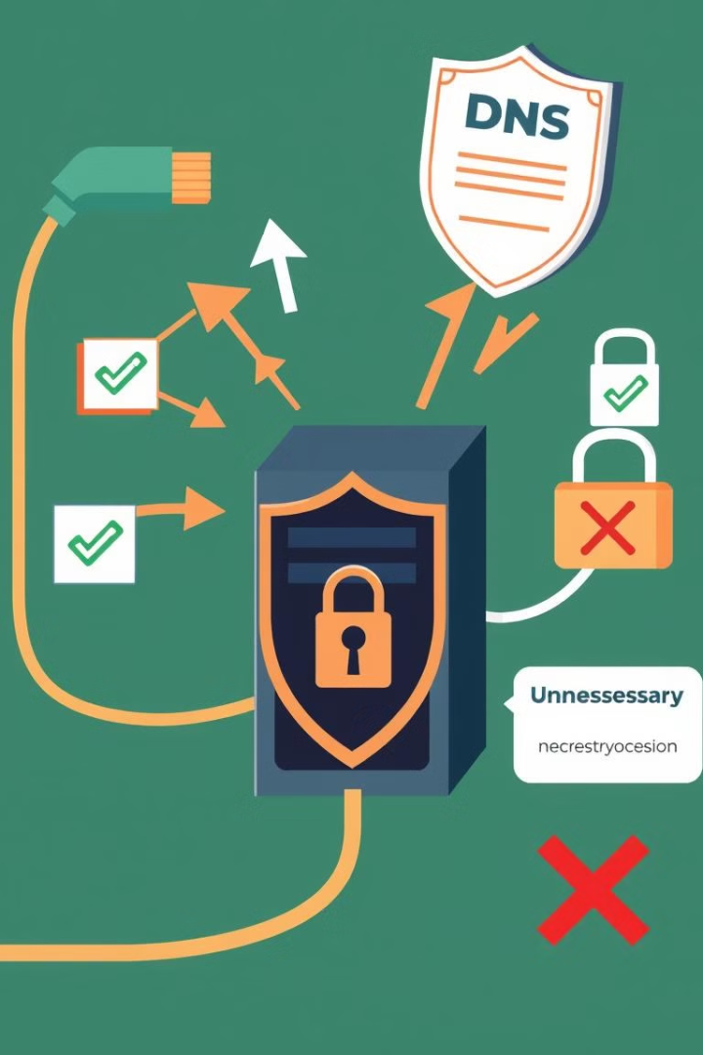
Hardening DNS Security
Use DNSSEC (Domain Name System Security Extensions):
Adds cryptographic signatures to prevent spoofing.
Enable Firewall Rules for DNS Traffic:
sudo firewall-cmd --add-service=dns --permanent
sudo firewall-cmd --reload
Disable Unnecessary DNS Recursion:
Edit /etc/named.conf and set recursion on;

Slide 16





Future of DNS
DNS over HTTPS
DNS over TLS
Encrypts queries for enhanced privacy.
Secures DNS traffic with encryption.
AI & Machine Learning in DNS
Blockchain-Based DNS
Decentralized approach to prevent manipulation and censorship.
Used for anomaly detection and threat prevention.

Slide 17

Advantages and Disadvantages of DNS
Advantages:
Disadvantages:
Enables easy-to-remember domain names.
Vulnerable to security attacks (e.g., DNS spoofing, DDoS).
Provides fast and efficient website access.
Caching reduces server load and speeds up queries.
If a DNS server fails, websites become inaccessible.
Distributed system ensures scalability and reliability.
Requires periodic updates and security patches.

Slide 18
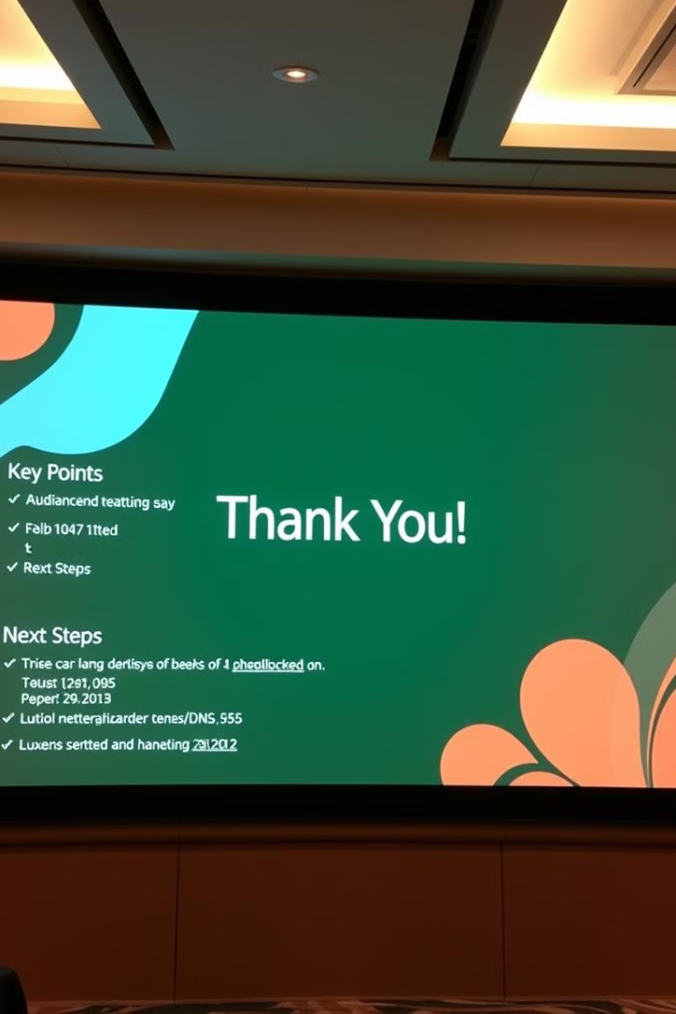
Conclusion
1
DNS is the foundation of internet communication.
2
It converts domain names into IP addresses efficiently.
3
Ensuring security with DNSSEC, DoH, and DoT is crucial.
4
Future innovations like AI-driven DNS and blockchain-based DNS will enhance reliability and security.

